Slide 1

DEVOPS

Slide 2
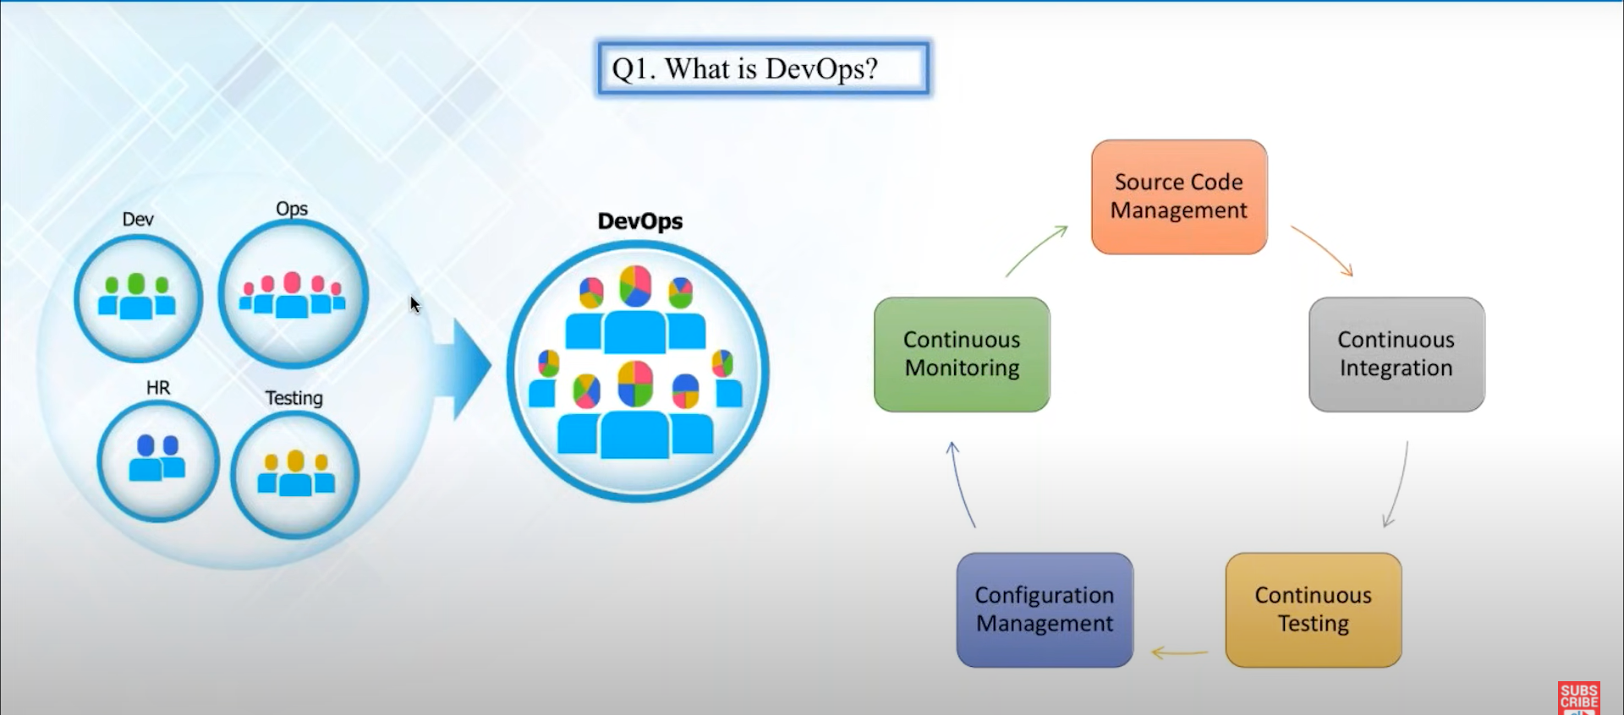

Slide 3
List the tools used in DevOps ?
1. Version Control tools
GitHub
Bitbucket
GitLab

Slide 4
2. Container Management tools
Docker
Kubernetes
Mesos
4. Deployment & Server Monitoring tools
Splunk
Datadog
Sensu
5. Configuration Management tools
Chef
Puppet
Ansible

Slide 5
6. CI / Deployment Automation tools
Bamboo
Jenkins
IBM UrbanCode
7. Test Automation tools
Test.ai
Selenium
Ranorex
8. Artifact Management tools
Sonatype NEXUS
JFRog Artifactory
CloudRepo

Slide 6
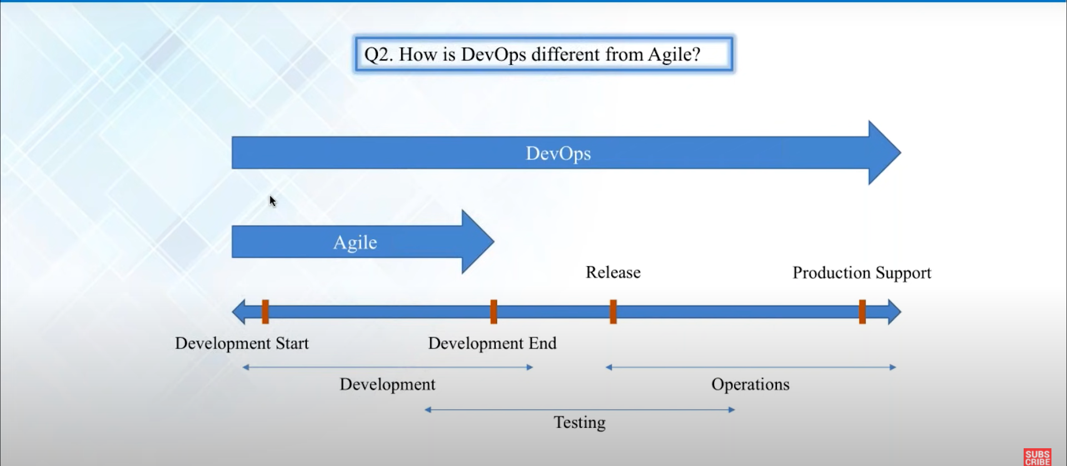

Slide 7
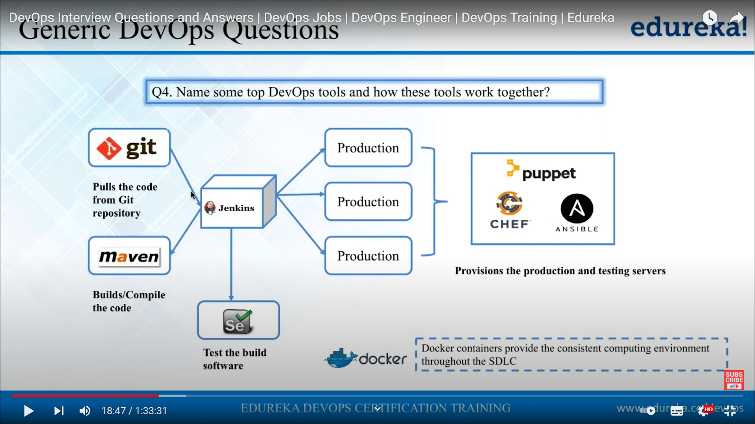

Slide 8
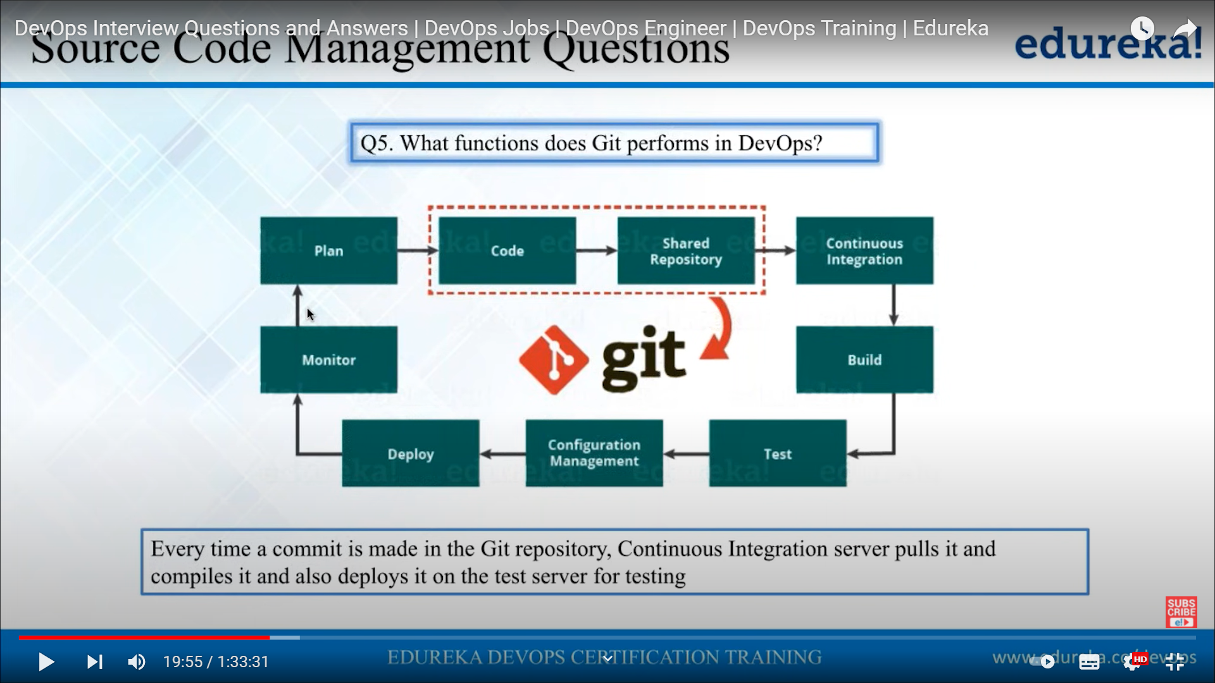

Slide 9
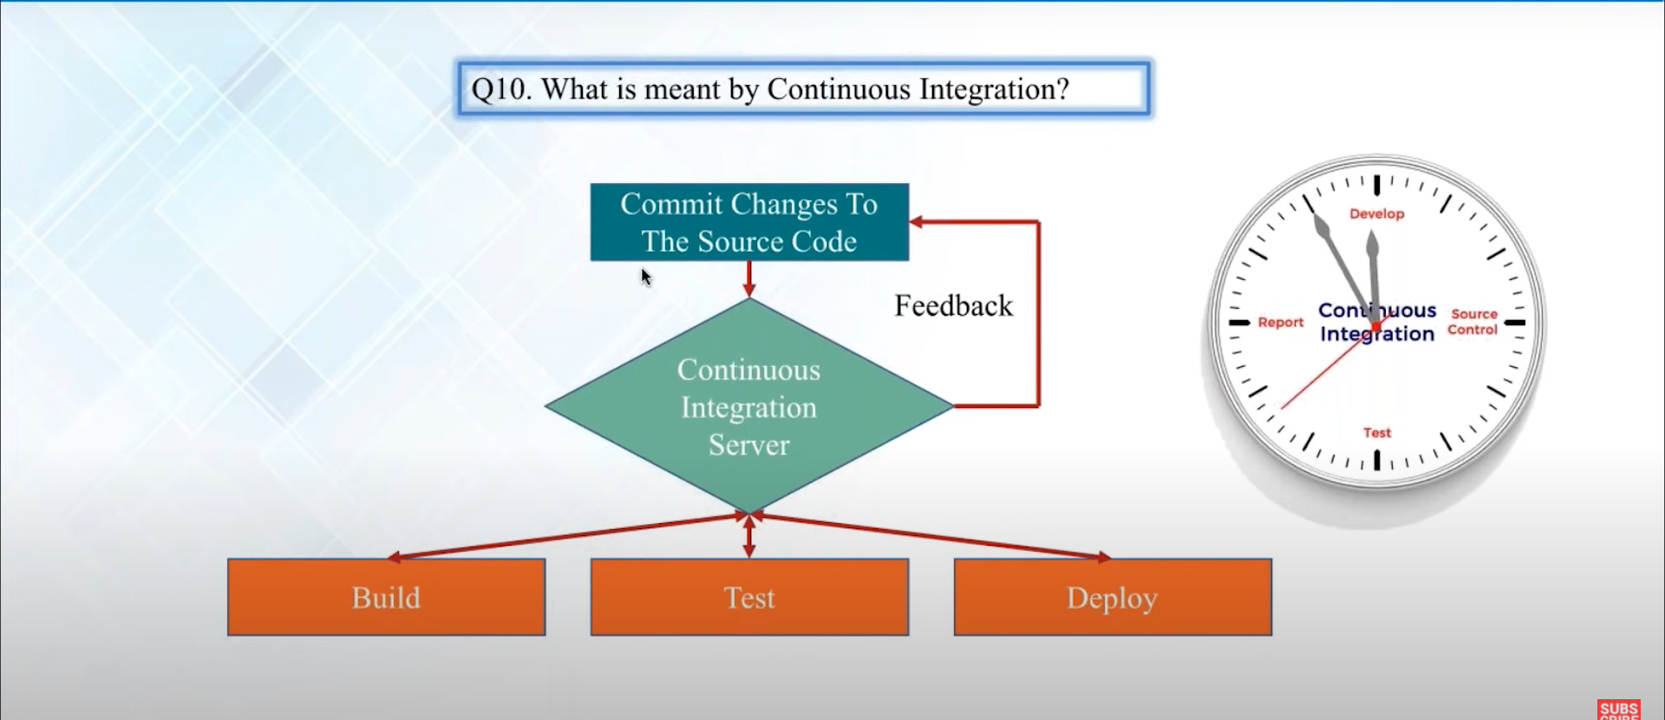

Slide 10
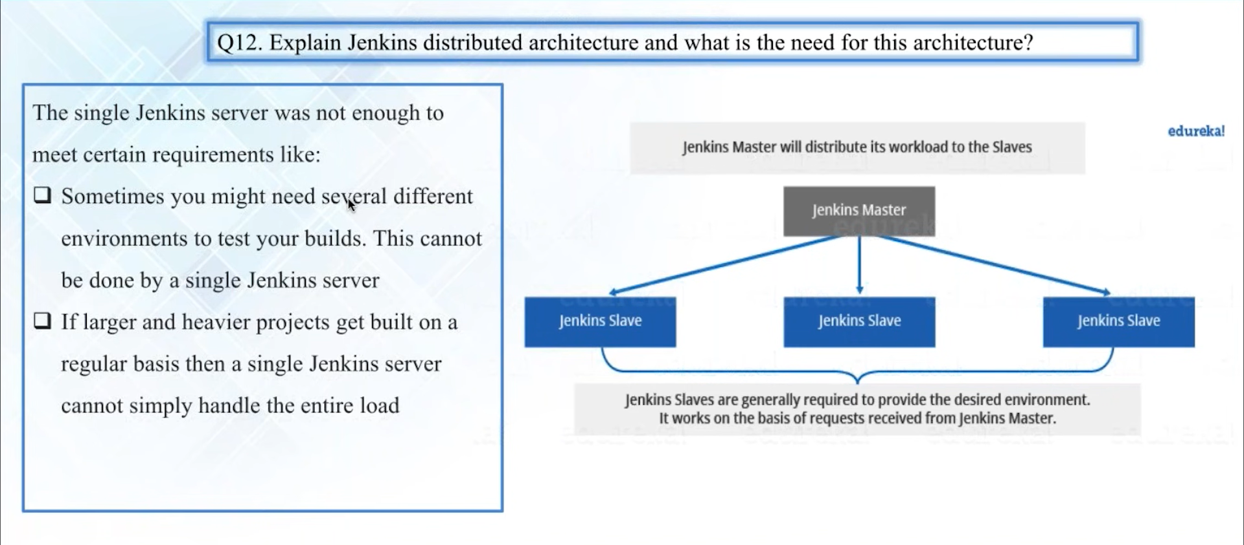

Slide 11
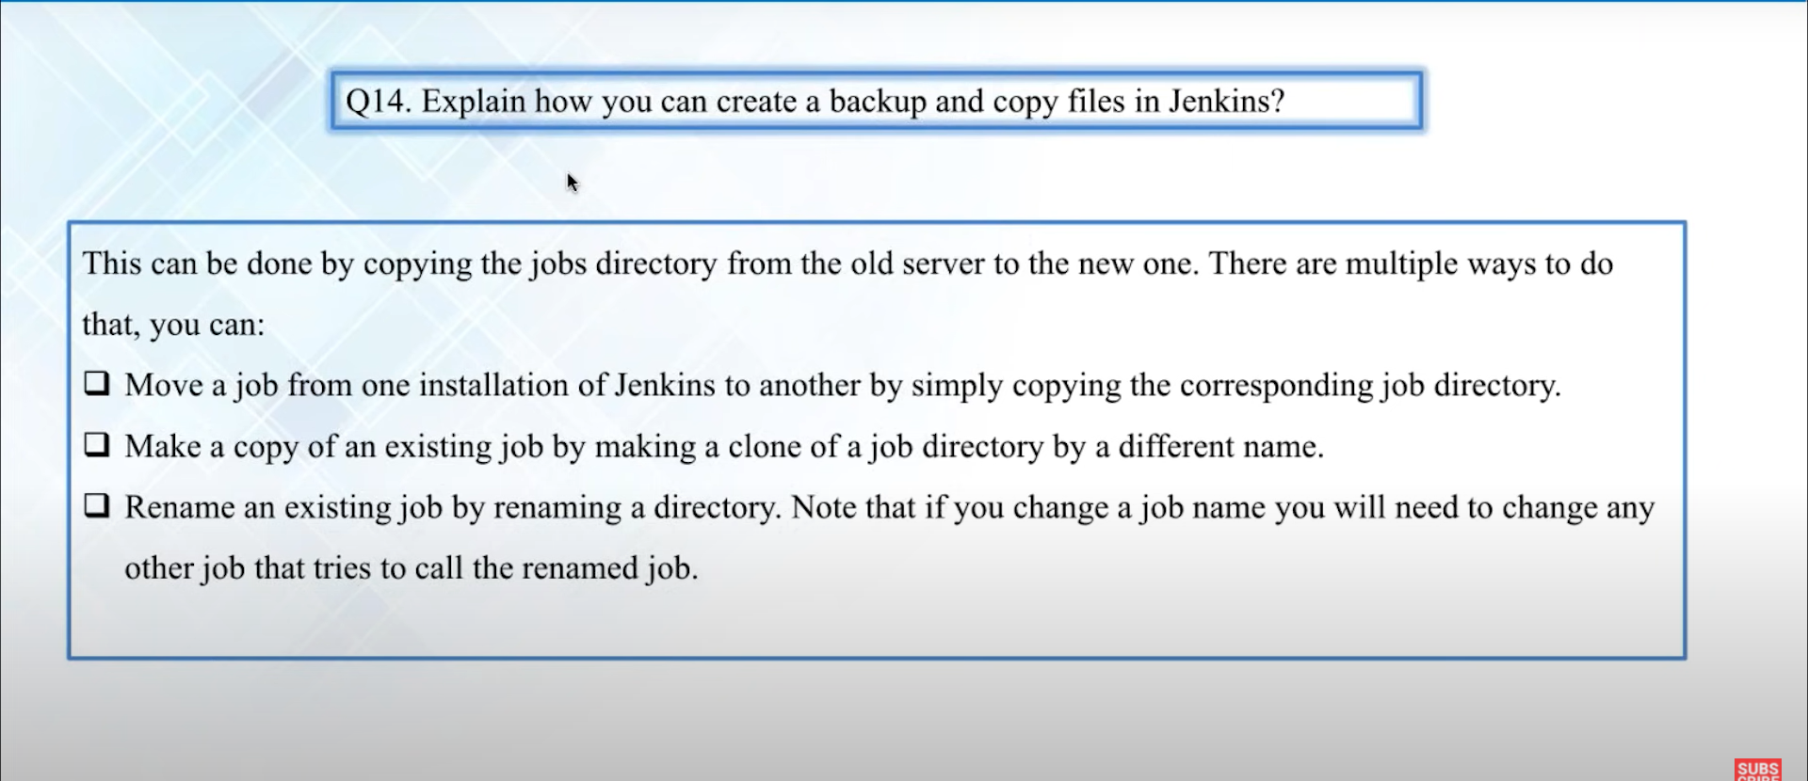

Slide 12
LINKS TO REFER
https://youtu.be/clZgb8GA6xI
https://www.qentelli.com/thought-leadership/insights/devops-tools

